Slide 1

Project:
Modern Data Pipeline for Slowly Changing Dimensions (SCD)
AWS, NiFi, & Snowflake ELT Architecture
Muhammad Affan bin Aamir

Slide 2





Presentation Roadmap: Mastering SCD in Snowflake
Project Goal & Overview
Why SCD is critical and the primary project objectives.
Architectural Design
The end-to-end data flow: Ingestion, Loading, and Transformation.
Snowflake ELT Core Components
Deep dive into Snowpipe, Streams, and Tasks automation.
SCD Demonstrations
Focus on Type 1, Type 2, Type 3, and Type 4 logic implementation.
Conclusion & Next Steps
Summary, key takeaways, and potential future enhancements.

Slide 3

The Business Challenge: Managing Evolving Dimensional Data
Project Goal
Design and automate a scalable ELT pipeline to maintain historical accuracy and integrity in crucial dimensional data (e.g., Customer, Product).
The Problem of Changing Dimensions
Customer attributes (e.g., address, email, title) change slowly over time. Traditional UPDATE statements overwrite history, leading to:
Inaccurate historical reporting (e.g., associating a past sale with a customer's current address).
Loss of valuable context for trend analysis and auditing.
Key Takeaway: We must preserve historical context for accurate business intelligence and compliance.

Slide 4
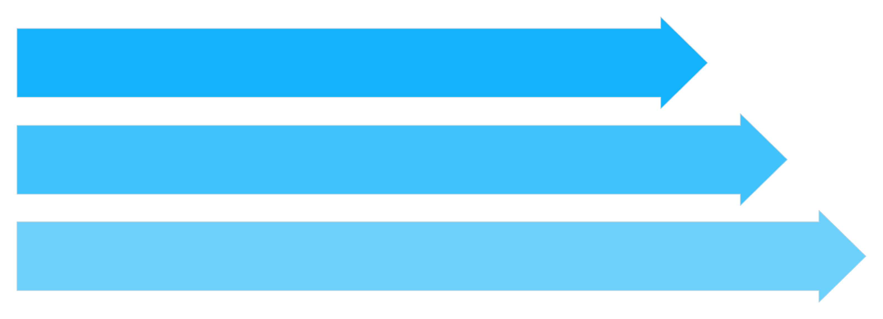
End-to-End Architectural Flow: AWS & Snowflake ELT
Data Ingestion
Data Loading
Data Transformation
1
2
3
Stage 1: Data Ingestion (AWS/NiFi)
Stage 2: Data Loading (Snowpipe)
Stage 3: Data Transformation (Snowflake)
Synthetic data is generated (Faker/Jupyter), processed via NiFi (running in Docker on EC2) for real-time flow control, and dropped into the S3 Landing Zone.
S3 events trigger the serverless Snowpipe, which continuously loads new files into the raw staging table (customer_raw) within Snowflake, eliminating batch delays.
Transformation is orchestrated within Snowflake using Streams & Tasks. This ELT approach centralizes complex SCD logic directly in the data warehouse.

Slide 5
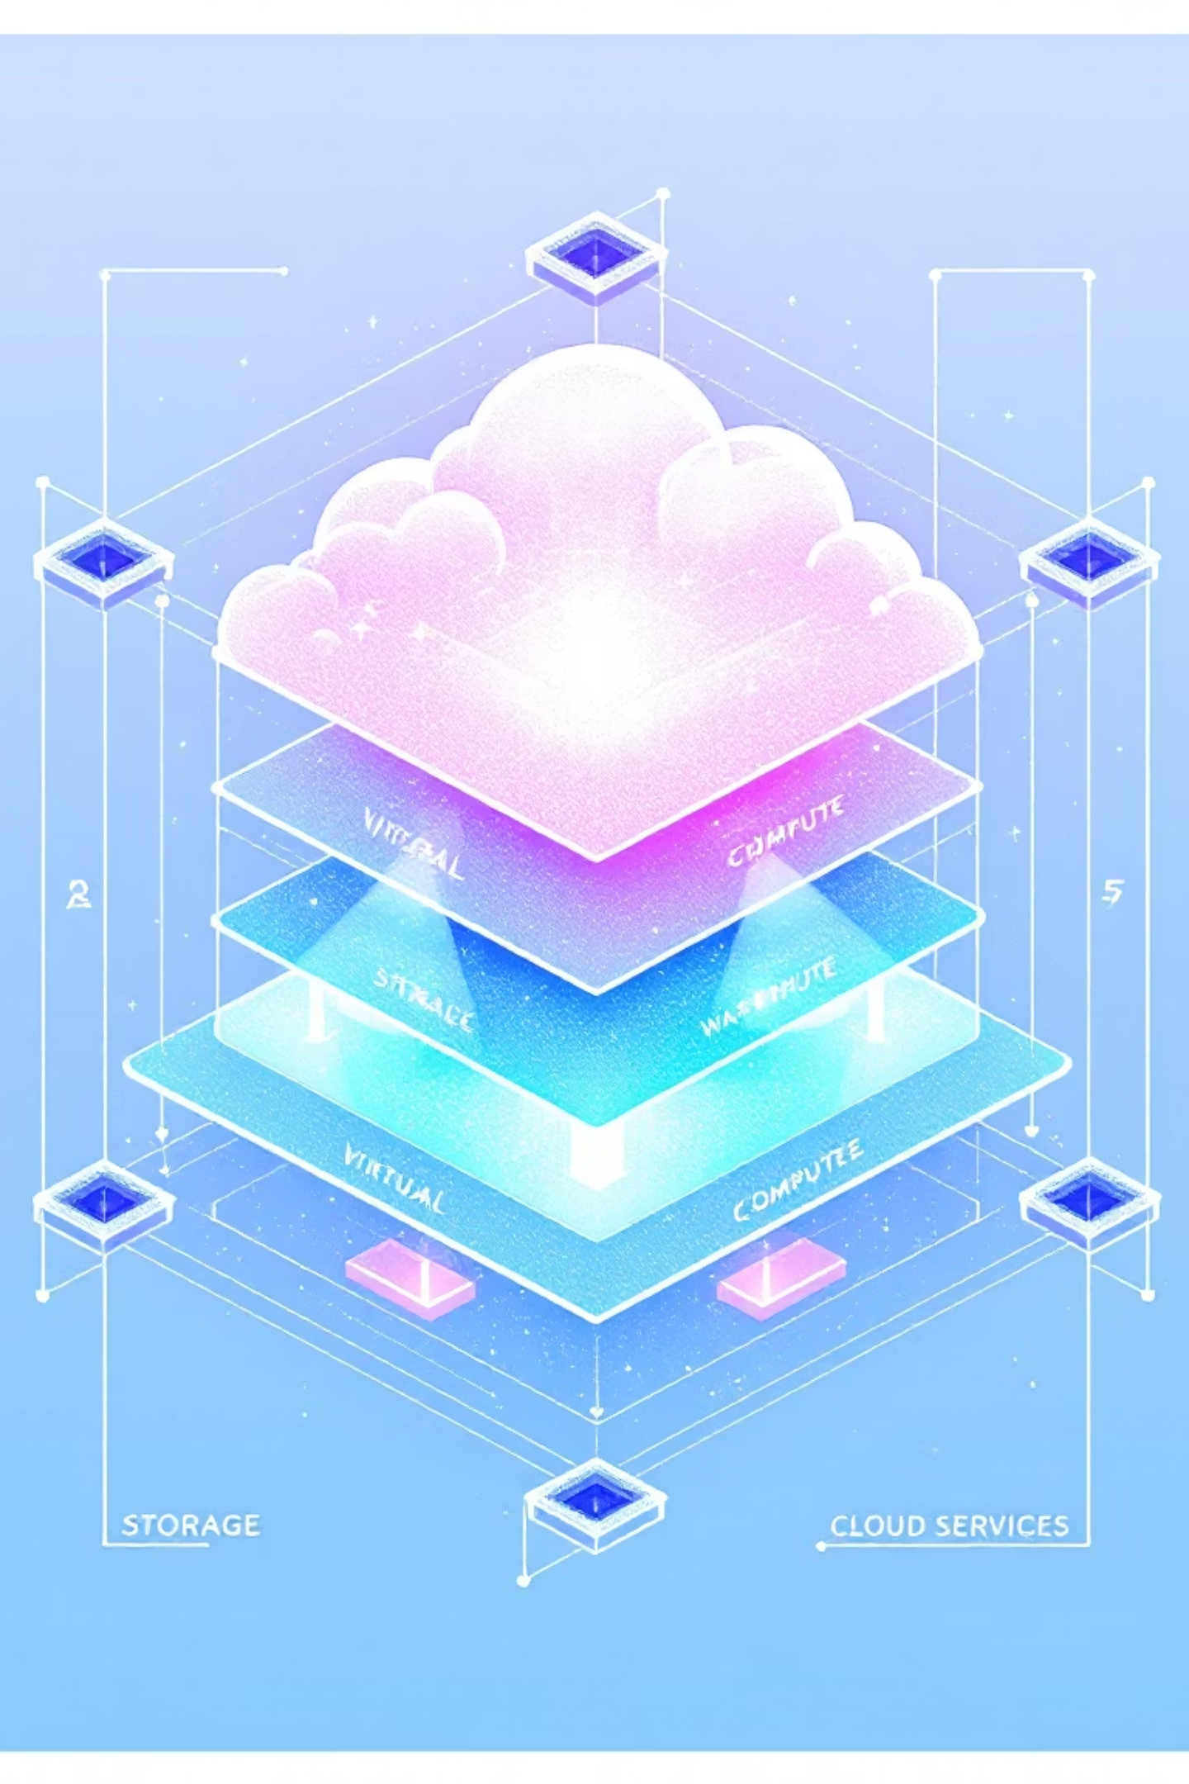




Leveraging Snowflake's Decoupled Architecture
Snowflake's unique design separates storage and compute, offering powerful scalability and efficiency for our ELT workload.
Snowpipe: Continuous Ingestion
Virtual Warehouses (VW): Compute Power
Provides serverless, automated data loading from S3. We use it to ensure a continuous flow of data without the need for manual COPY statements or heavy resource utilization.
Dedicated compute clusters used for the heavy lifting (e.g., executing the complex MERGE statements inside our Tasks). Compute scales independently from storage cost.
Cloud Services Layer
Manages essential functions like authentication, metadata storage, query optimization, and the orchestration services (Tasks and Streams) that drive our SCD process.

Slide 6




ELT Transformation Engine: CDC with Streams & Tasks
This combination forms the automated, efficient core for handling Slowly Changing Dimensions.
Stream
Task
Captures Data Manipulation Language (DML) changes (INSERT, UPDATE, DELETE) on the raw staging table. It acts as the Change Data Capture (CDC) source, tracking what has changed.
Automated scheduler (e.g., SCHEDULE = '1 MINUTE') that triggers the ELT logic. It executes the Stored Procedure only when the Stream detects new data.
MERGE Statement
Stored Procedure
The core SQL command that conditionally inserts, updates, or deletes records in the target dimension table based on the stream data.
Encapsulates the complex JavaScript/SQL MERGE logic. This ensures transactional control, reusability, and execution efficiency for the SCD updates.
Analogy: The Stream tracks the changes; the Task is the engine that executes the changes; the Stored Procedure provides the rules for execution.

Slide 7


SCD Type 1: Overwrite (Latest State Only)
Concept: History is Sacrificed for Simplicity
SCD Type 1 updates existing records directly. When a dimension attribute changes, the old value is overwritten, meaning historical context is PERMANENTLY LOST.
When to Use: For attributes that do not require historical tracking, such as typos, corrections, or non-critical, frequently changing fields (e.g., a customer's current nickname).
This is the simplest SCD implementation, requiring only a basic MERGE statement.
Key SQL Logic: MERGE Update
WHEN MATCHED AND (c.email <> cr.email OR c.phone <> cr.phone)
THEN UPDATE SET c.email = cr.email,
c.update_timestamp = CURRENT_TIMESTAMP()

Slide 8

SCD Type 2: Full Historical Tracking
Concept: Preserving Every Version
SCD Type 2 preserves all historical versions of a record by adding a new row to the dimension table for every detected change. The primary key remains the surrogate key, but the natural key (e.g., customer ID) will appear multiple times.
Version Columns: start_time, end_time, and a boolean flag is_current determine the active record.
Mechanism: This involves complex two-part logic: first expiring the old row (UPDATE), then inserting the new row (INSERT).
Implementation Complexity
Implementation requires advanced SQL constructs within the Stored Procedure, often utilizing Window Functions (e.g., LAG) to identify when a new version of a record is truly needed, followed by a multi-step MERGE operation against the history table.

Slide 9
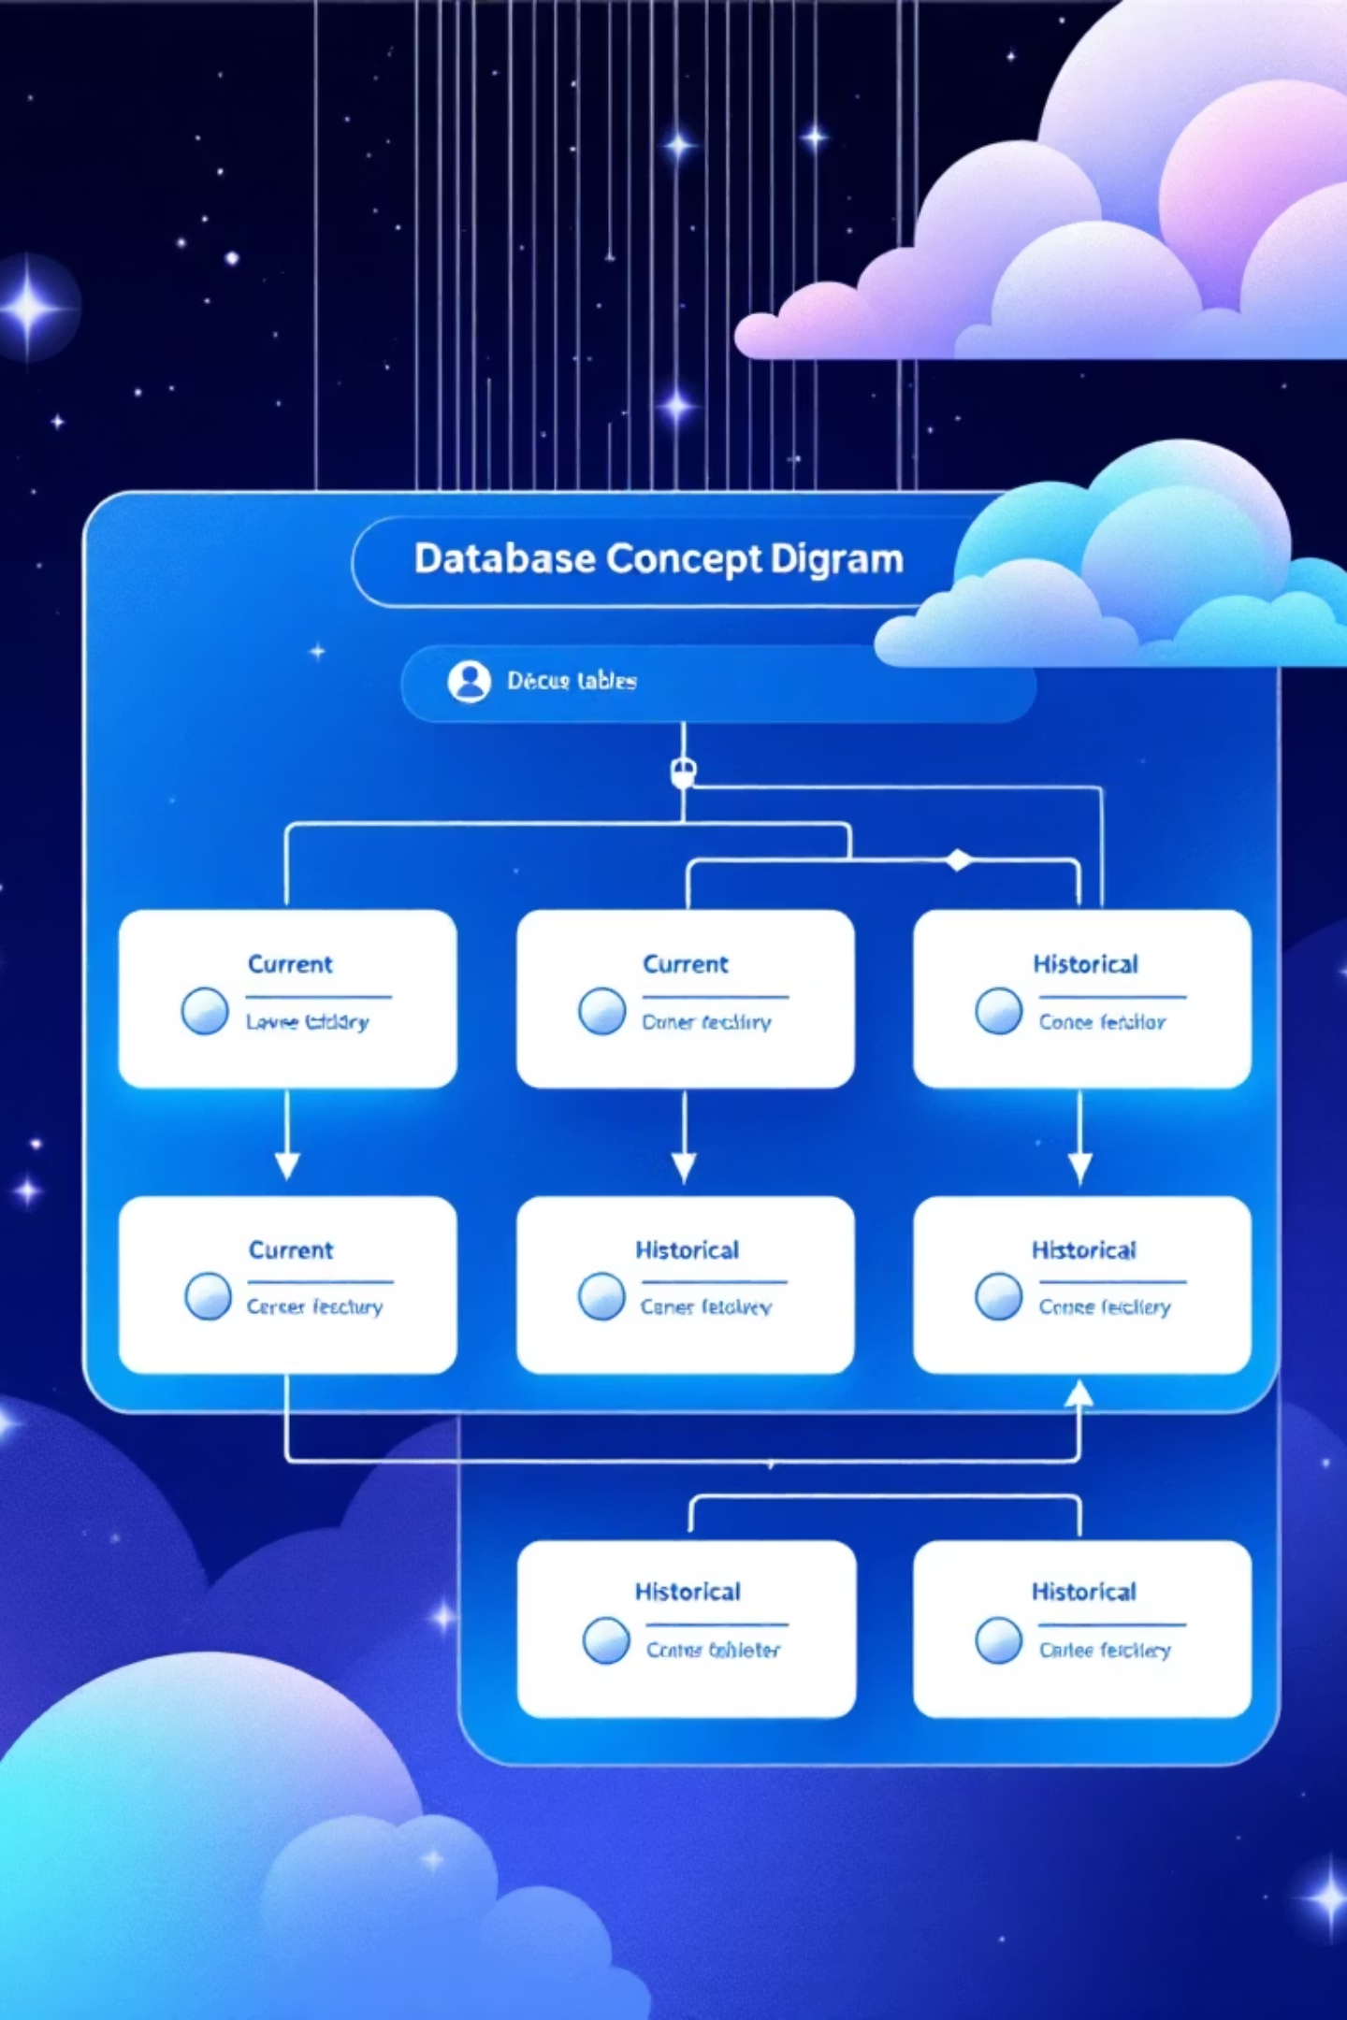
SCD Type 3 & Type 4: Hybrid Approaches
SCD Type 3: Partial History
Concept: Tracks the current value and one previous value for selected attributes within the same row.
Example Columns: current_email and previous_email.
Benefit: Highly efficient, requiring only one row per customer, and perfect for comparing "current state" versus "last known state" quickly.
SCD Type 4: Full Hybrid
Concept: Uses two tables for lookup speed and historical depth:
Dimension Table (SCD T1): Current state only, optimized for rapid transactional lookups.
History Table (SCD T2): Full historical audit trail, used for deep historical analysis.
Benefit: Combines the fast lookup speed of Type 1 with the comprehensive history of Type 2.

Slide 10
Project Summary & Future Scope
100%
4
1
Automation
SCD Types
Platform
Achieved continuous, automated ELT pipeline via Snowpipe and Snowflake Tasks, reducing manual effort to zero.
Successfully implemented and automated SCD Types 1, 2, 3, and 4 logic using Streams, Tasks, and optimized SQL MERGE statements.
Centralized all transformation logic within Snowflake, leveraging its scalability and cloud-native features.
Future Enhancements
Error Handling & Observability
Security & Best Practices
Data Testing & Validation
Implement robust logging and automated notification (e.g., using SNS or email integration) for Task failures and data quality issues.
Replace hardcoded AWS Access Keys with secure IAM Roles and Snowflake Storage Integrations for all external access.
Integrate dbt (Data Build Tool) for testing data quality and transformation logic, ensuring consistency across all SCD types.

